Slide 1
MedLife
Revolutionize HealthCare Shopping with E-Pharmacy
Presented BY:
Fahmida Akter Rapa 2013903042
Rahimul Haque Afrad 2021885642
Wakib Jahan Galib 2021057642
Jubair Hossain 2021626642

Slide 2
Introduction
E-pharmacy, an e-commerce platform for online medications, has launched to provide patients with the best possible experience when buying prescription drugs. The features we have implemented here are the Registration part, Payment options, shop, cart option, payment method, payment history, diagnosis, and live chat. Patients will get all types of medicines in an easy way to purchase and payment. Patients can view their purchase history and what they cart in the shop. In the diagnosis option, patients can choose what doctor they need and get an instant appointment .On the other hand, there is a live chat where patients can chat with the admin about their problems.

Slide 3
Key Features
Registration and Log In
Shopping and Cart
Payment Methods
History of Payments
Diagnosis
Live Chat
Admin Dashboard
Responsive

Slide 4
Tools
Frontend – HTML, CSS,API
Backend – Python Flask
Database – MySQL LocalHost
IDE – VS code

Slide 5
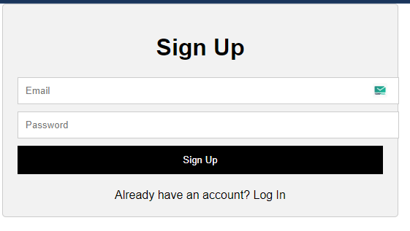
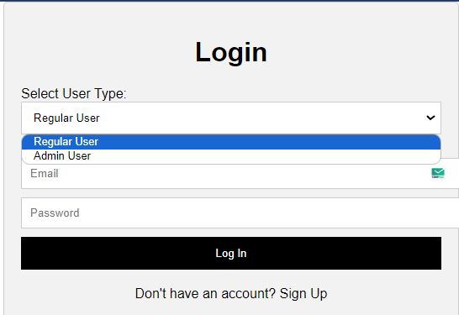
Registration and Log In

Slide 6
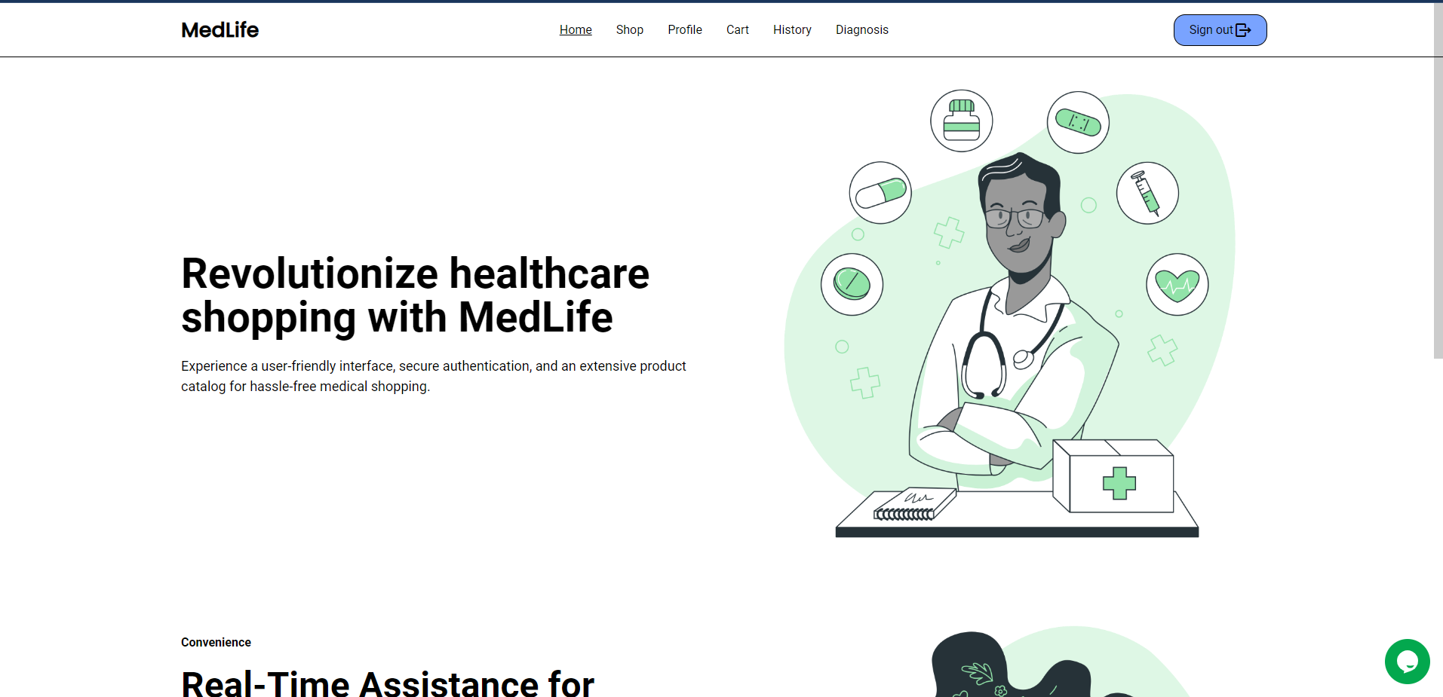
Homepage

Slide 7
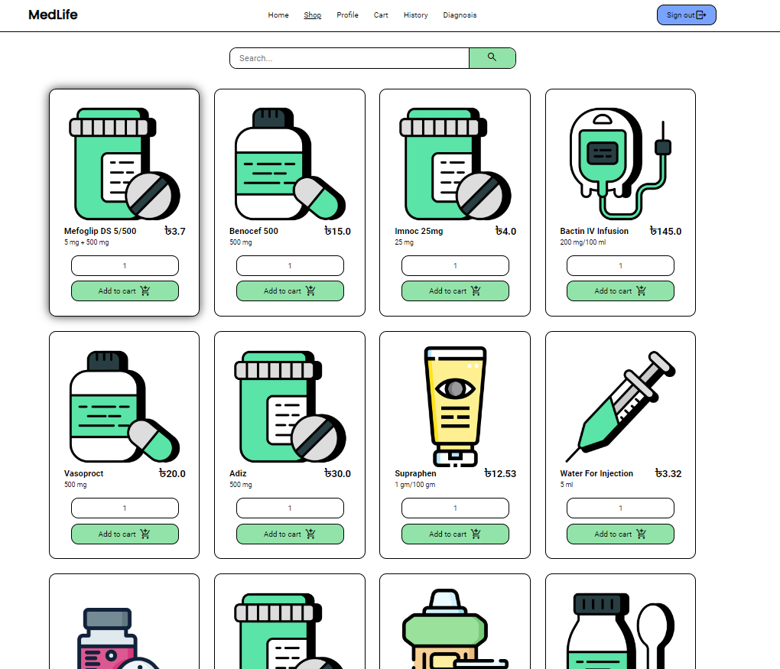
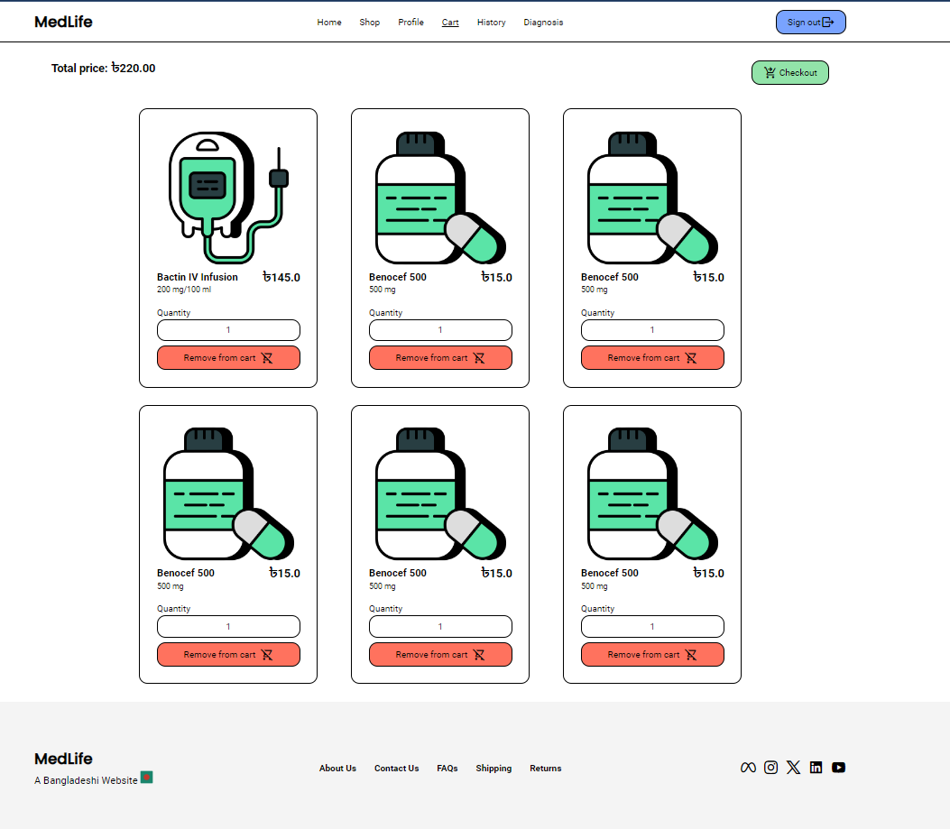
Shop Page
Cart
Cart

Slide 8
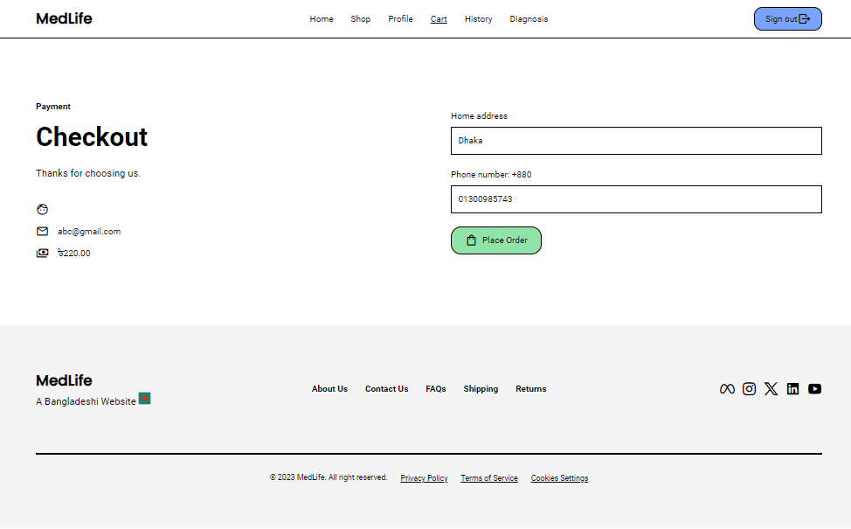

Checkout Page
Payment Methods

Slide 9
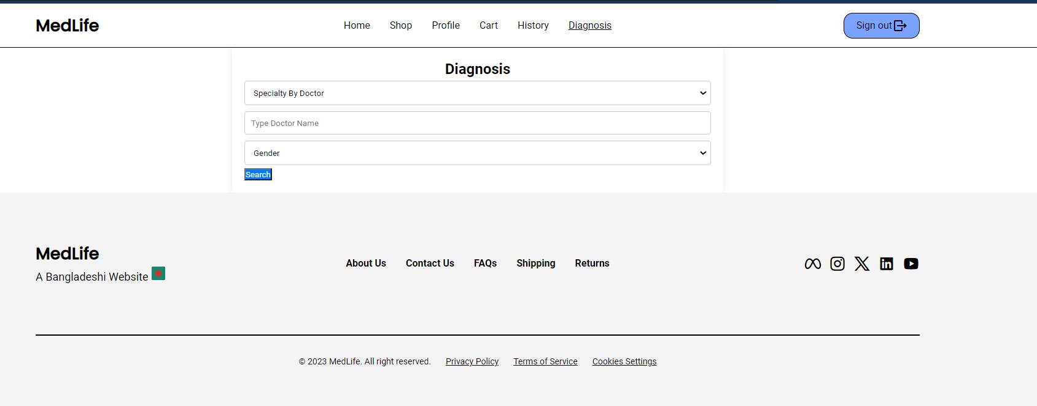
Diagnosis

Slide 10
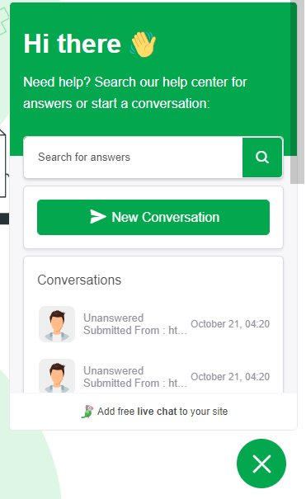
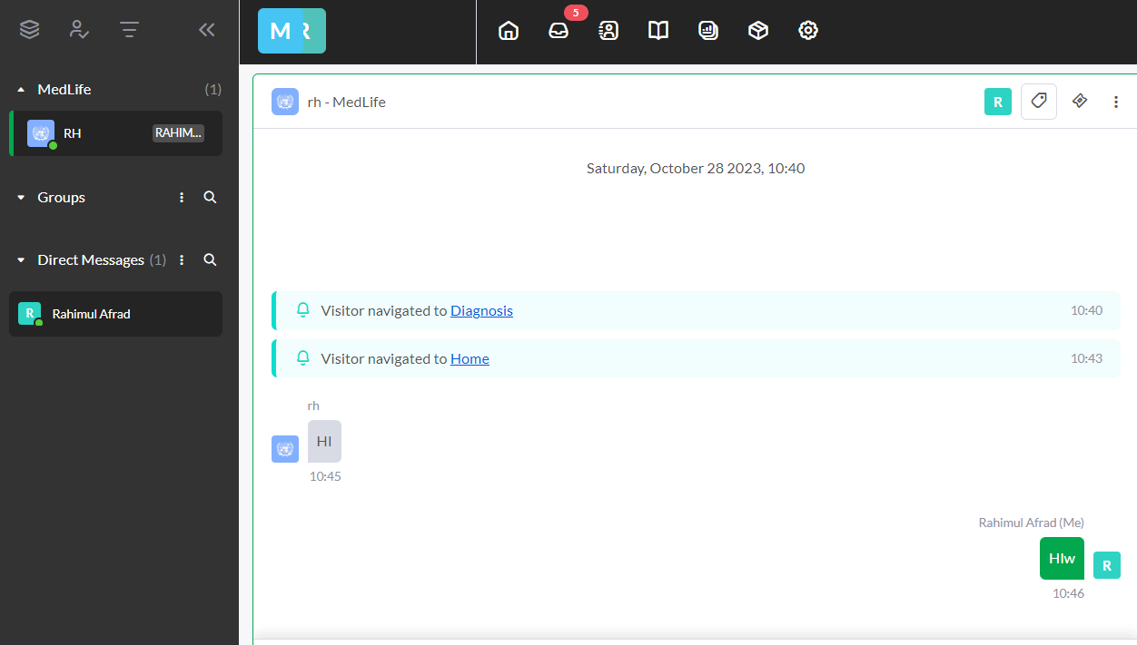
Live Chat

Slide 11
Design Patterns Strategy Design Pattern Factory Design Pattern Switch Design Pattern Decorator Design Pattern Singleton Design Pattern

Slide 12
Strategy Design Pattern
This pattern defines a family of algorithms, encapsulates each one, and makes them interchangeable. In this specific example, you have created payment strategies (CreditCardPaymentStrategy and PayPalPaymentStrategy) that can be set for an order, allowing for different payment methods to be used interchangeably.

Slide 13
Factory Design Pattern
The Factory Method pattern is a creational design pattern that defines an interface for creating objects but allows subclasses to alter the type of objects that will be created. In this specific example, you've implemented a User Factory to create different types of users, such as Regular User and Admin User.

Slide 14
Switch Design Pattern
Switch pattern uses switch cases to select the appropriate behavior for a given situation based on a value, we achieved similar behavior using conditional statements, like if, elif, and else in our code since Python doesn't have a built-in "switch" statement like some other languages.

Slide 15
Decorator Design Pattern
Decorator pattern takes a function as its argument and returns a different function. In our case we returned a decorated function within the decorator function which also works on adding additional feature to the decorator function.

Slide 16
Singleton Design Pattern
singleton pattern is used to creating a class that will ensure that only one instance of that class exists throughout the lifespan of the application to provide a global point of access to a resource. In our case we used it to configure out payment gateway settings.

Slide 17
Conclusion
In conclusion, the use of design patterns in this project demonstrates a commitment to best practices in software design. These patterns contribute to a more organized, scalable, and maintainable system, allowing for future growth and improvements.

Slide 18
Thank You!

